Slide 2
DNA sequencing
18th April 2017
Bishop Stopford School

Slide 3
Kim Judge & Fran Gale
Ask questions any time
Short intro then practical
Mr Harwood will have a copy of these slides
Let us know if you don’t want to be filmed

Slide 4
Why am I here today?
I used to go to Bishop (and so did all my family)

Slide 5
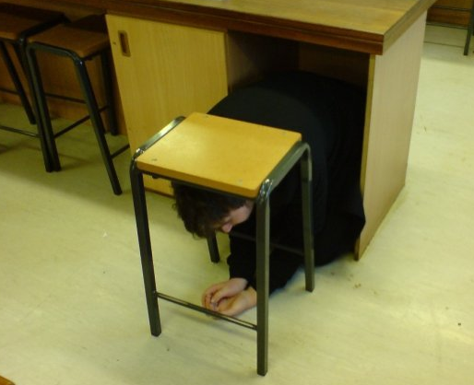
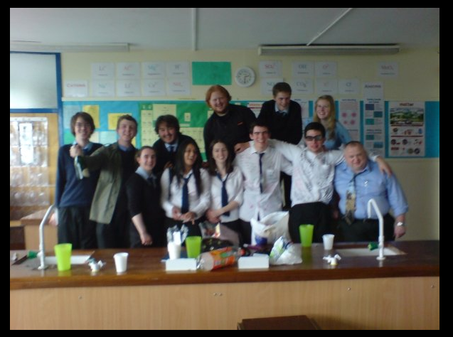
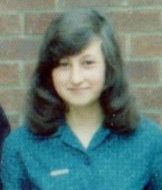
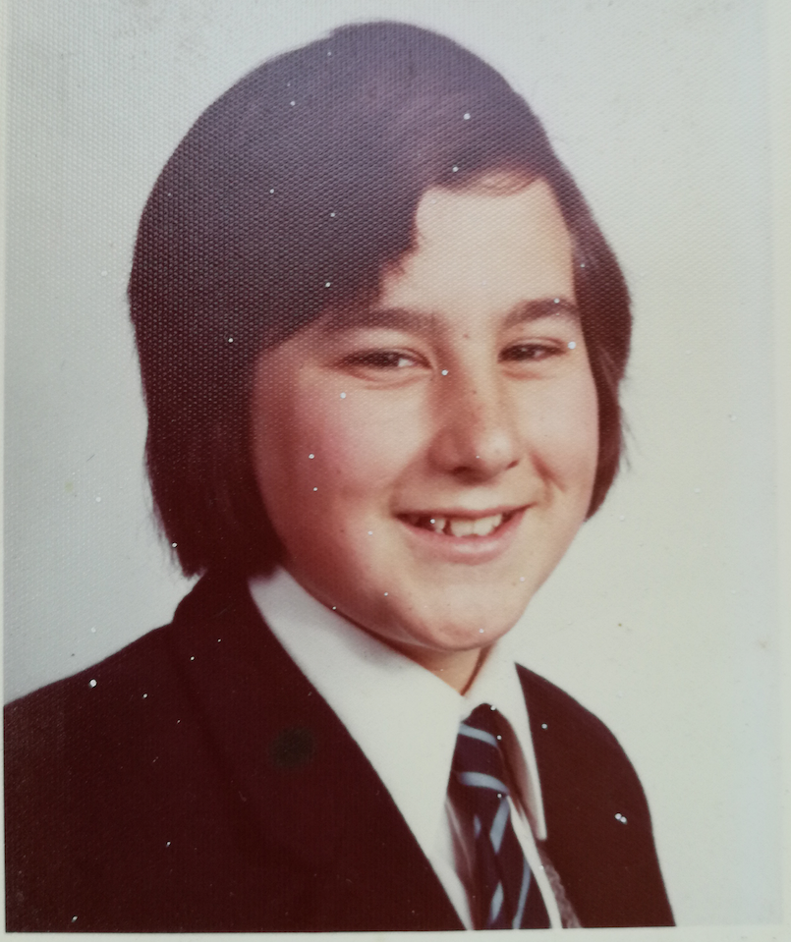
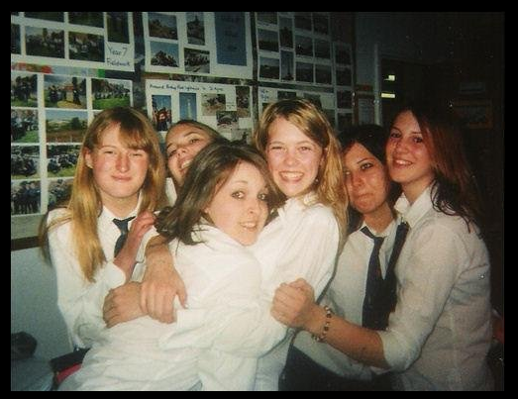

Slide 6
Why am I here today?
I used to go to Bishop (and so did all my family)
When I left Uni I became a scientist working on DNA sequencing

Slide 7
DNA sequencing - the first genomes …
First DNA sequence Yeast Human
1977 1996 2001
Bacteria Worm 1,000 genomes
1995 1997 2008-2015

Slide 8
The human genome project
3 billion base genome - 3 Gigabases – and cost $3 billion
Collaboration between scientists and a competition too!
A combination of different people’s DNA
Now, the human genome sequence is publicly accessible, as are many other species

Slide 9
100,000 genomes
Today we can sequence a human genome for ‘$1,000’
For more money, we can sequence a human in one day!
100,000 genomes project makes use of cheap sequencing at large genome centres like Wellcome Trust Sanger Institute
Sequencing for cancer & rare diseases led by NHS England

Slide 10
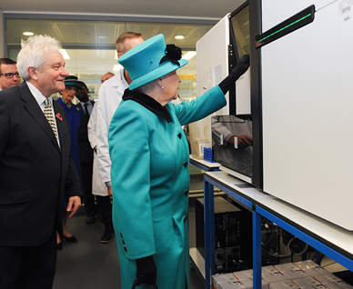
The Queen starting a sequencing run on an Illumina HiSeq

Slide 11
Sanger Institute
We still use those machines all the time today
The Sanger Institute has rooms full of sequencing machines that reliably produce large amounts of data
Each machine costs about $1,000,000
A thousand people work on site extracting DNA to be sequenced, running the sequencing machines and, analyzing the data from them

Slide 12
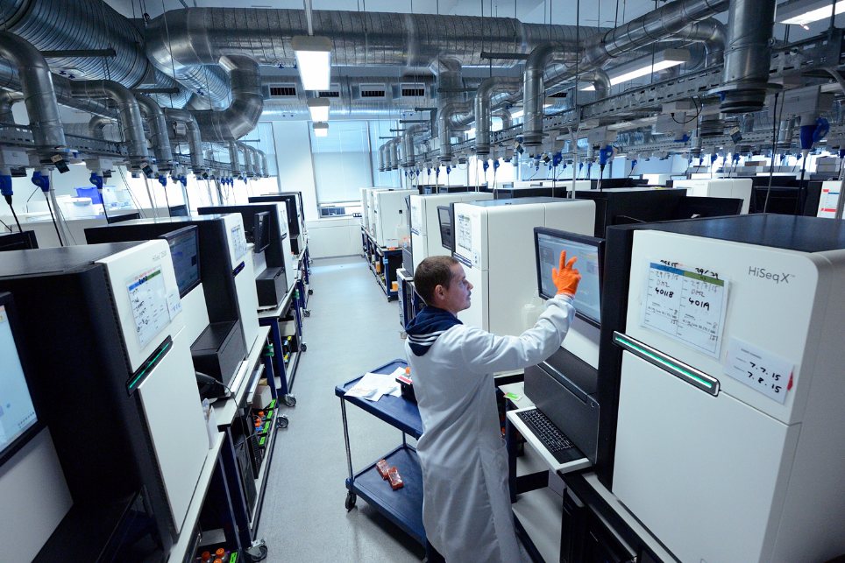

Slide 13
Why is it called the Sanger Institute?

Slide 14
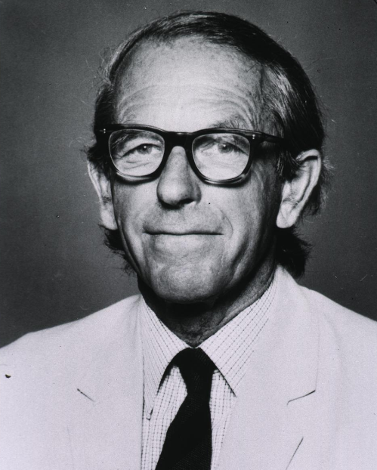
Frederick Sanger
2 Nobel Prizes – Protein sequencing and DNA sequencing
Refused a knighthood
“A knighthood makes you different, doesn’t it, and I don’t want to be different”
Retired at 65 in 1983 and died not long ago in Cambridge

Slide 15
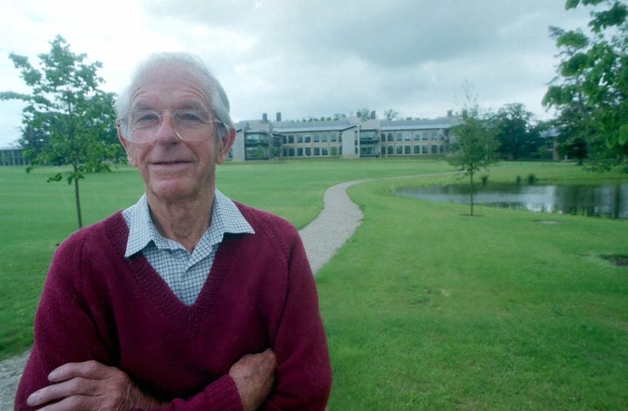

Slide 16
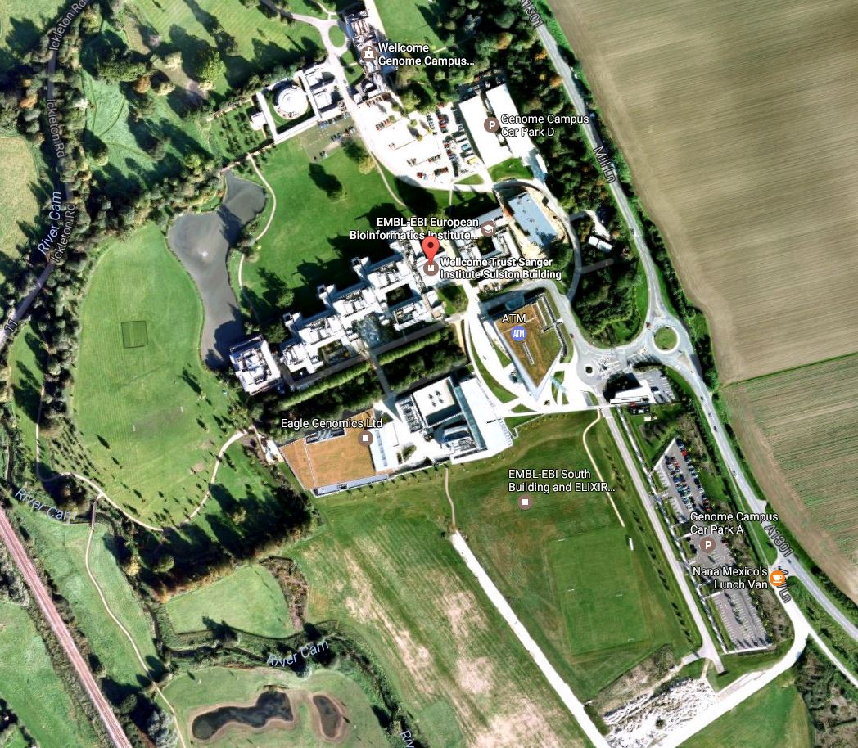

Slide 17
What does this have to do with today?

Slide 18
What does this have to do with today?
A new type of DNA sequencer has been invented called the MinION

Slide 19
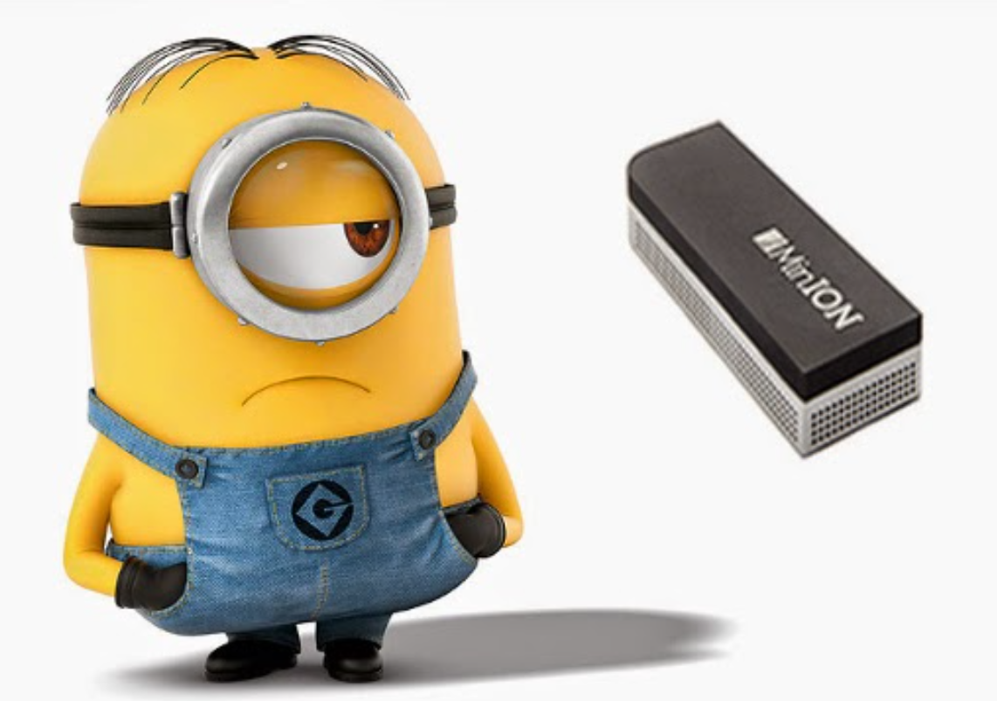

Slide 20
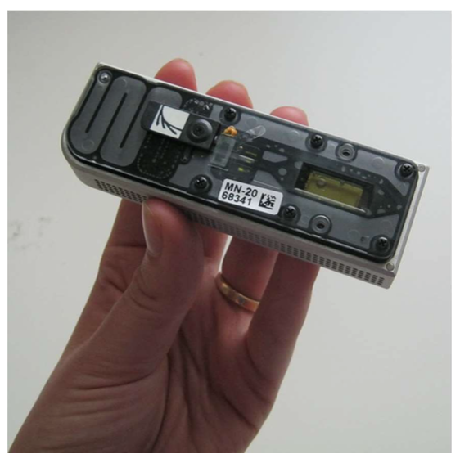

Slide 21
Why is it so small?
Other machines need to have cameras and lasers to take pictures of the DNA
They need to have moving parts to add chemicals to make the sequencing happen
The MinION measures electrical signals from DNA that is already there

Slide 22
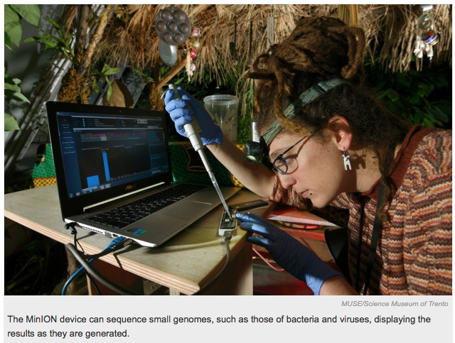
http://www.nature.com/news/pint-sized-dna-sequencer-impresses-first-users-1.17483

Slide 23
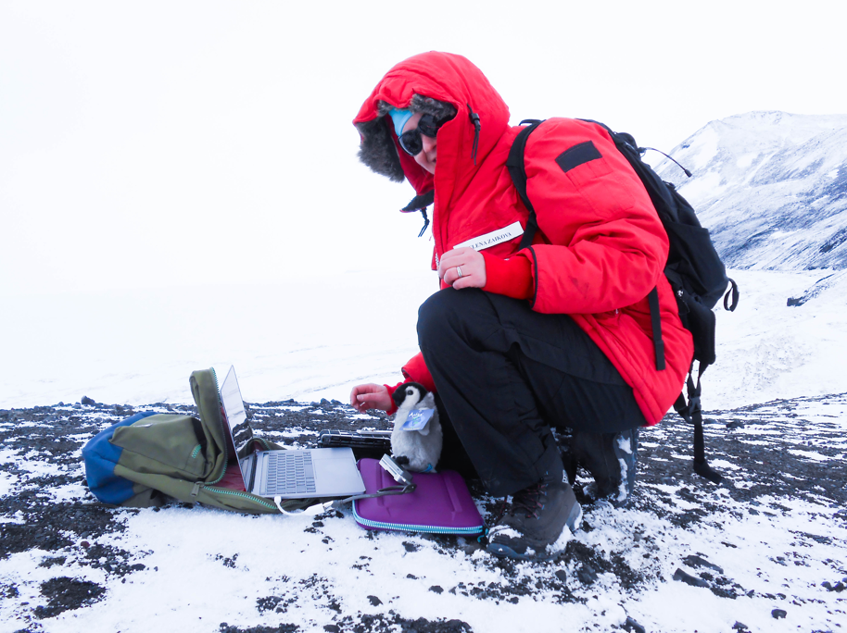

Slide 24
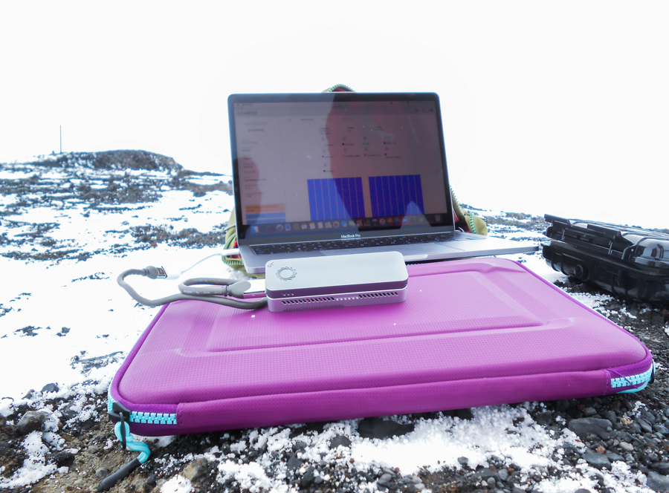

Slide 25
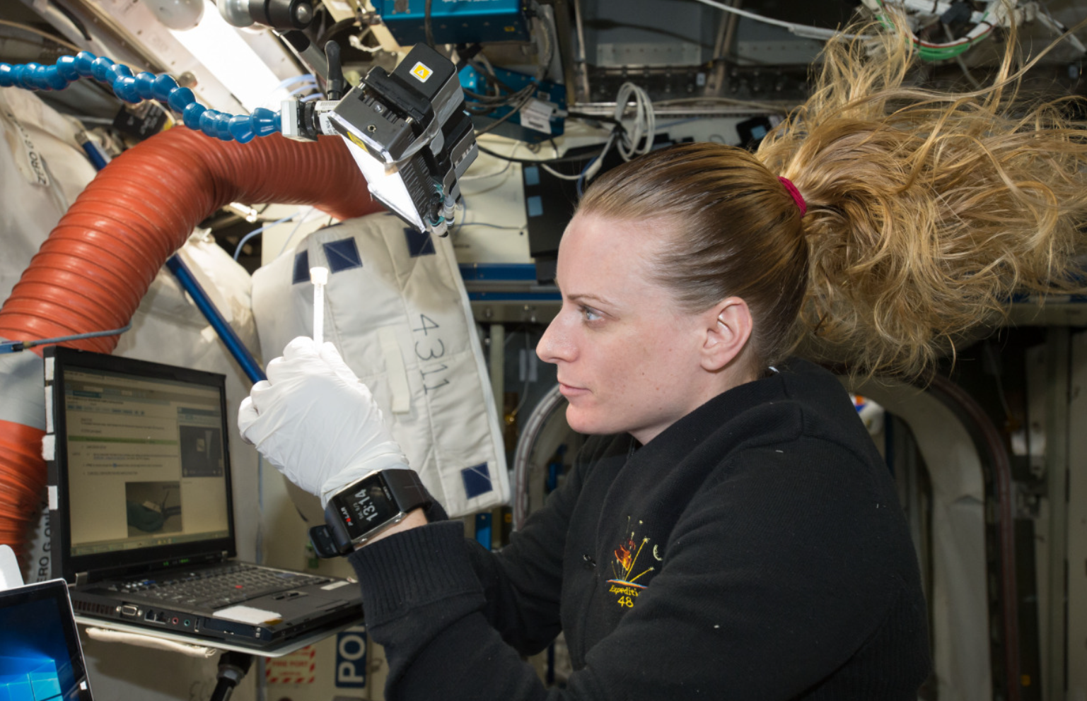

Slide 26
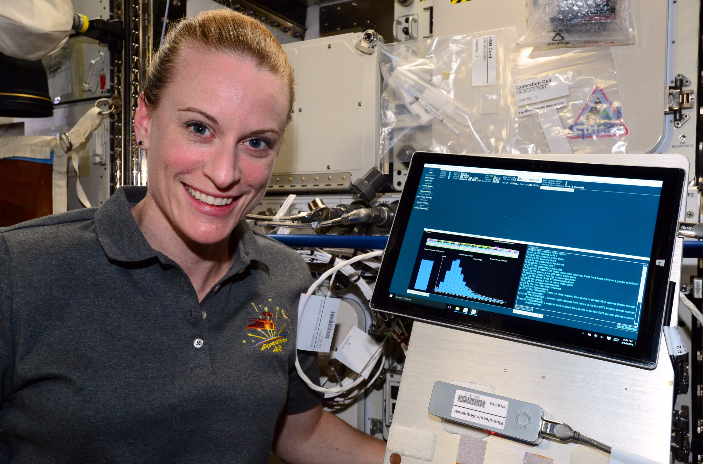

Slide 27
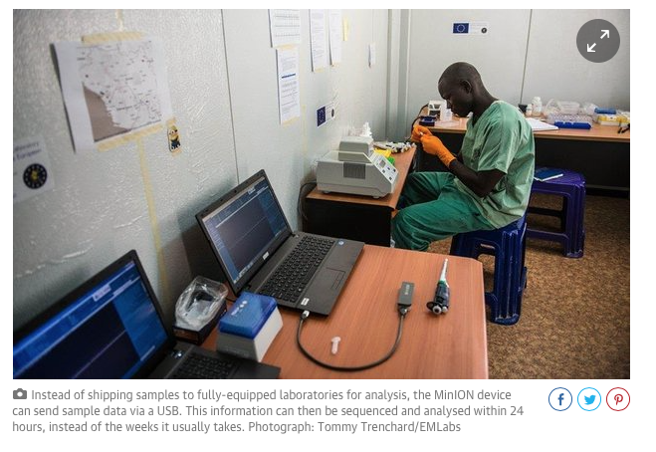
Image from The Guardian Online
https://www.theguardian.com/science/2016/feb/03/from-ebola-to-zika-tiny-mobile-lab-gives-real-time-dna-data-on-outbreaks

Slide 28
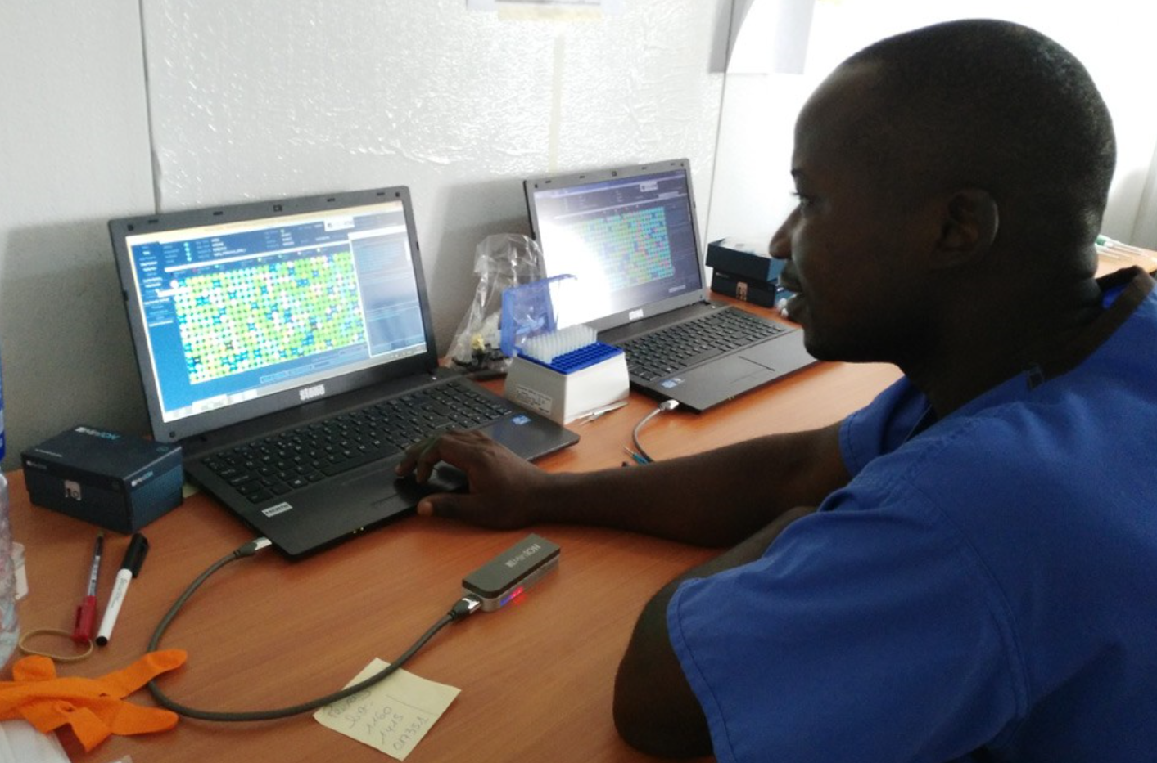

Slide 29
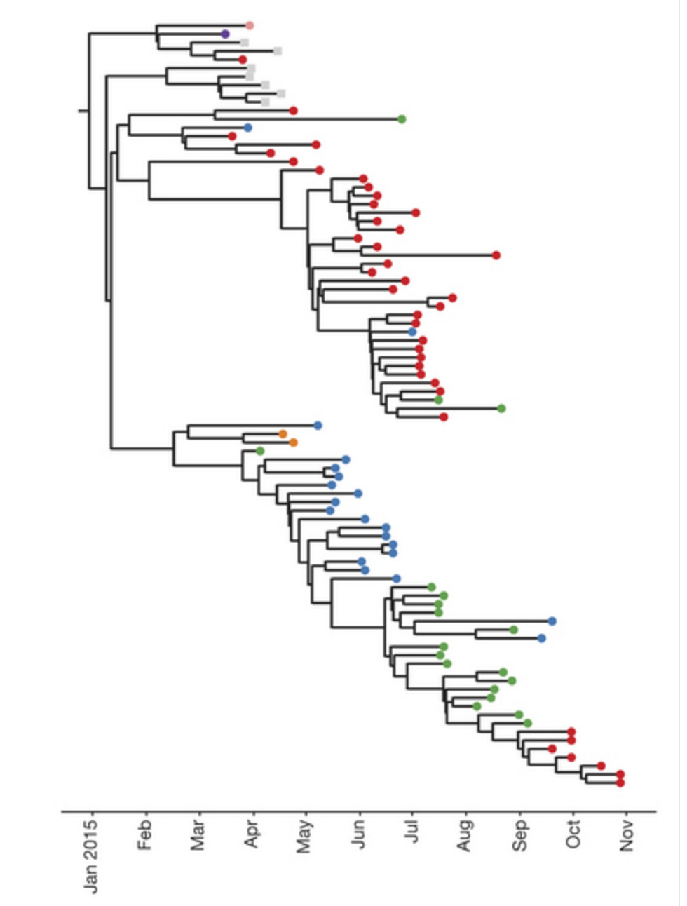
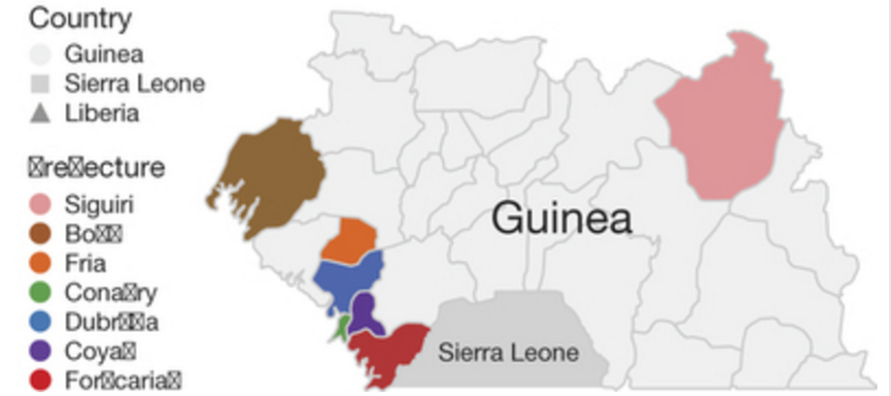

Slide 30
So, what are we going to sequence?

Slide 31
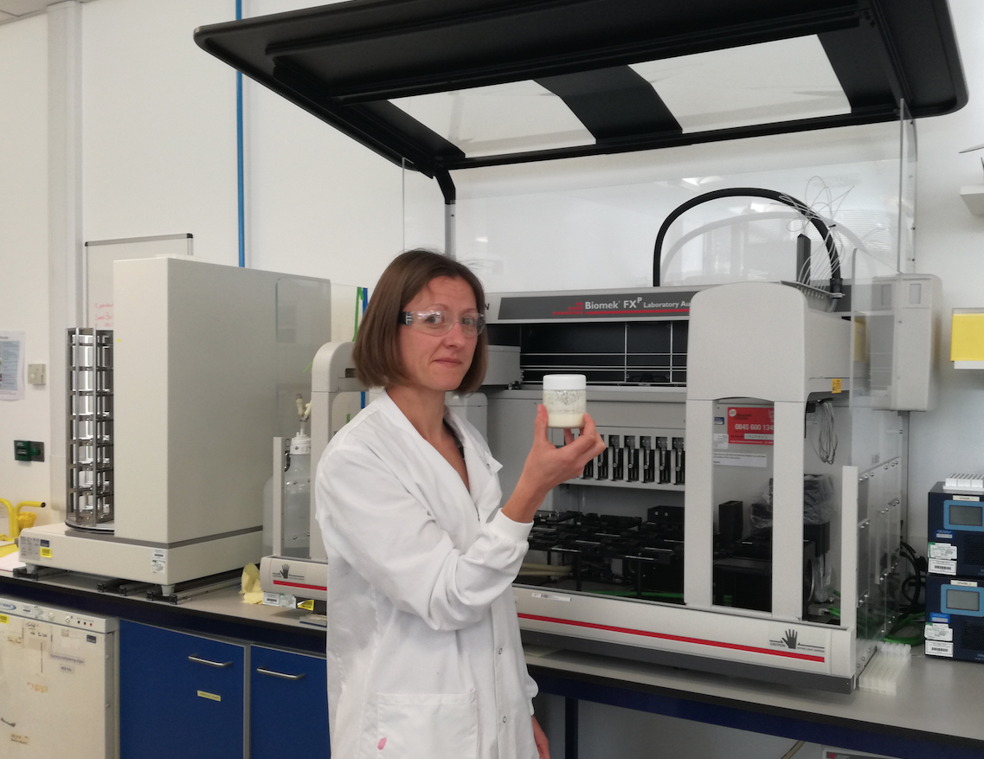
This is Naomi. She makes her own kefir

Slide 32
What is kefir?
It’s a fermented milk drink, similar to a yoghurt
It can be made from cow’s, goat’s or sheep’s milk, or plant based milks such as soy, rice, oat or coconut
The starter culture is grains of bacteria, yeasts, milk proteins and sugars clumped together into a cauliflower like structure

Slide 33
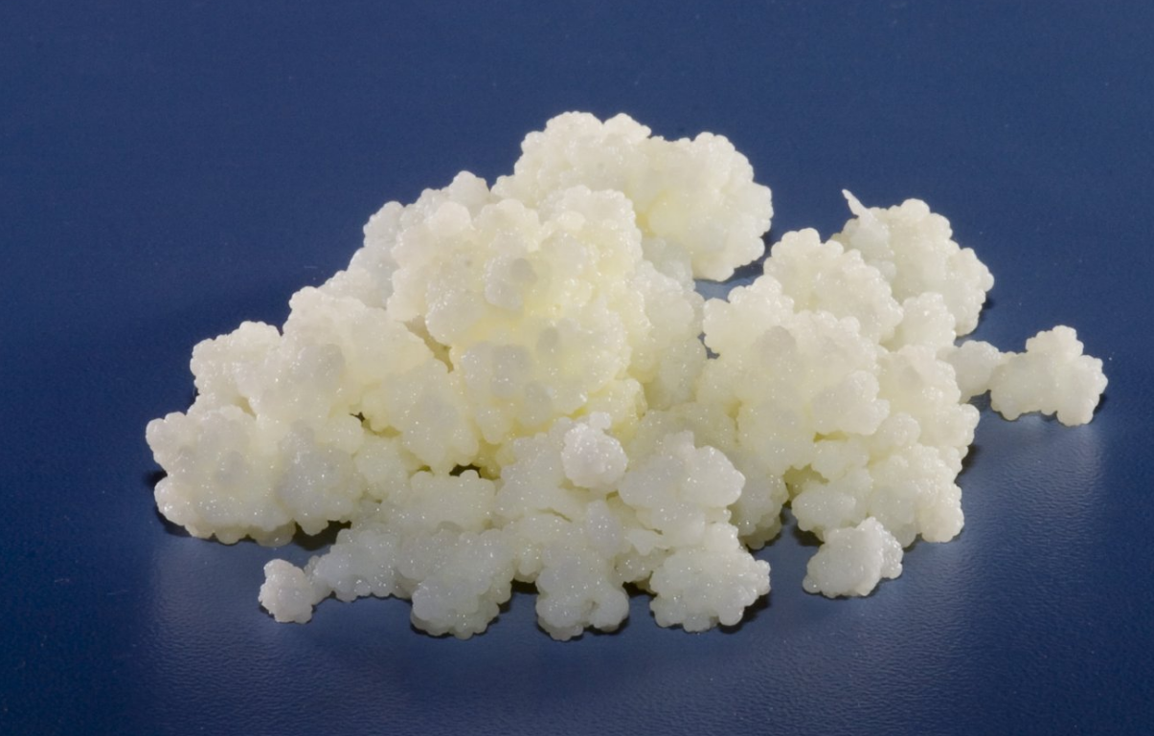

Slide 34
But what’s really in it?

